Slide 1


Implementing HTTPS Client and Servers in Node.js
HTTPS (Hypertext Transfer Protocol Secure) is an extension of HTTP that uses SSL/TLS to encrypt the data transferred between clients and servers, ensuring secure communication over the internet. In Node.js, HTTPS can be easily implemented using the built-in https module, which provides methods for creating secure HTTPS servers and clients. This module handles the encryption and decryption of data, making it straightforward to establish secure connections in Node.js applications.
-22H51A05C6
CSE-D

Slide 2



Creating a Secure HTTP Server
1
Generating SSL/TLS Certificates
2
Configuring HTTPS Server
Set up SSL/TLS certificates to enable HTTPS and secure your Node.js server.
Learn to create an HTTPS server using the built-in Node.js HTTPS module.
3
Handling HTTPS Requests
Understand how to manage and respond to HTTPS requests on your server.

Slide 3






Building HTTPS Clients
Import HTTPS Module
Start by importing the HTTPS module from Node.js.
Set up Options
Configure the client options, including the SSL/TLS certificate details.
Make HTTPS Requests
Utilize the HTTPS module to make secure HTTP requests to your server.

Slide 4
Handling HTTPS Headers and Query Parameters
HTTPS Headers
Query Parameters
Middleware Integration
Learn to manage and set custom headers in your HTTPS requests and responses.Metadata sent with requests and responses over HTTPS, used for controlling data flow, authentication, content type, and security policies.
Understand how to handle and parse query parameters in your HTTPS communication.Key-value pairs appended to a URL, used for passing data and filtering results in an HTTPS request.
Explore the use of middleware to streamline HTTPS header and parameter handling.used for processing requests, adding features, and managing errors before reaching the final route handler.

Slide 5

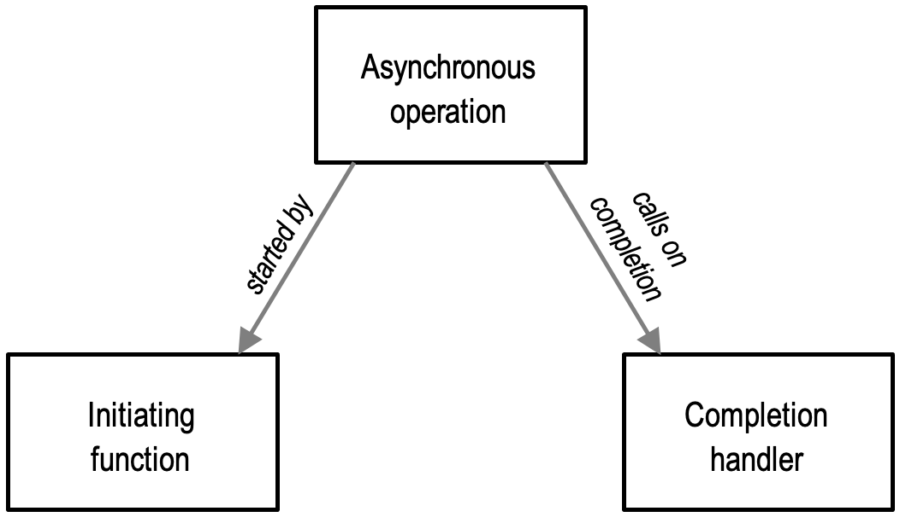
Asynchronous HTTPS Operations
1
Callbacks
Leverage callbacks to handle asynchronous HTTPS requests and responses.
2
Promises
Utilize Promises to simplify and manage the flow of asynchronous HTTPS operations.
3
Async/Await
Explore the use of async/await syntax to further streamline asynchronous HTTPS code.

Slide 6


HTTPS Error Handling
Certificate Errors
Network Errors
Occur when SSL/TLS certificates are expired, untrusted, or mismatched, requiring validation and secure handling.
Include timeouts and dropped connections; handled by retrying, logging, or notifying users.
Response Errors
Logging and Debugging
Arise from invalid or unexpected server responses, needing proper error messages or fallback logic..
Use logging and debugging techniques to identify and resolve HTTPS-related issues.

Slide 7






Secure HTTPS Communication Best Practices
Certificate Management
Encryption Algorithms
Properly manage and rotate SSL/TLS certificates for optimal security.
Choose appropriate and up-to-date encryption algorithms for HTTPS communication.
Security Policies
Monitoring and Logging
Establish and enforce robust security policies for your HTTPS infrastructure.
Implement comprehensive monitoring and logging for HTTPS-related activities.

Slide 8


Conclusion and Next Steps
Implementing HTTPS in Node.js secures data transmission between clients and servers by encrypting communication. Node.js simplifies this with its built-in https module for both client and server-side operations. HTTPS ensures data integrity and confidentiality, protecting against interception and tampering. By following best practices for certificate management and encryption, developers can build robust, secure applications. Utilizing Node.js’s asynchronous capabilities enhances efficiency in handling secure requests.

